Slide 1
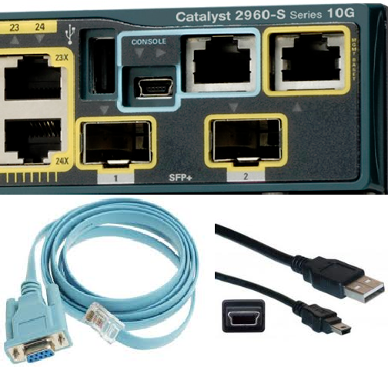
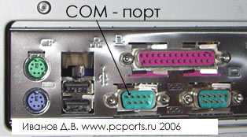
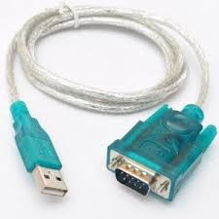

Connecting to network equipment
Possible connection methods:
Using a console cable
Telnet / SSH
Web interface
Specialized software (SDM, CSM, IME)
What do you need to connect?
Computer / Laptop
Console cable
Usb-to-Com adapter
Putty / SecureCRT / Teraterm
COM=RS232

Slide 2
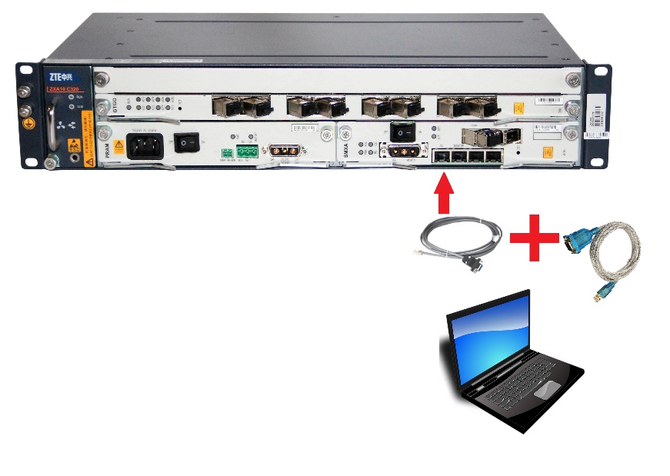
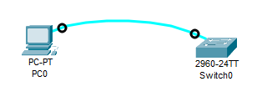
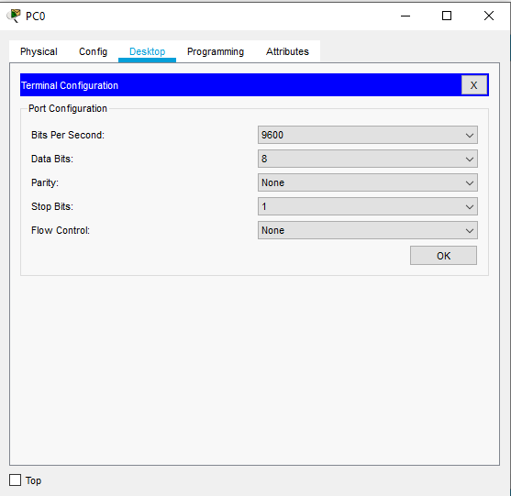
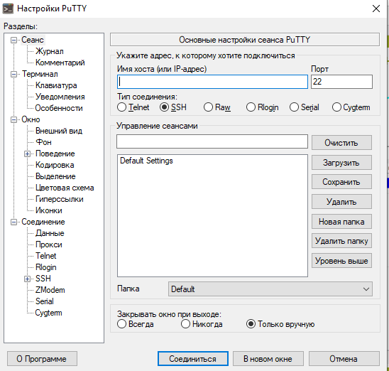
Putty.exe
Connecting to network equipment

Slide 3
Connecting to network equipment
Command Mode | Command to switch to this mode | Default Device Prompt
User EXEC Mode | - | Switch> Router>
Privileged EXEC Mode | enable (en, ena …) | Switch# Router#
Configuration mode | configure terminal | Switch(config)# Router(config)#
Line Configuration Mode | line console 0 | Switch(config-line)# Router(config-line)#
 | line vty 0 4 | Switch(config-line)# Router(config-line)#
Interface Configuration Mode | interface fastEthernet 0/1 (fa 0/1) | Switch(config-if)# Router(config-if)#
 | interface gigabitEthernet 0/1 (gi 0/1) | Switch(config-if)# Router(config-if)#
 | interface vlan 1 | Switch(config-if)# Router(config-if)#

Slide 4
Connecting to network equipment
?
<Tab> button
Short versions of the command
Exit and end
Show commands
Show clock
Clock set
Show running-config
Hostname
Passwords
Banner motd
Save configurations
Ping
No shutdown

